Slide 1
EMPLOYEE SALARY PREDICTION USING LINEAR REGRESSION
CAPSTONE PROJECT
Presented By:
Atul Singh (Roll no - 2208390100021)
Rajkiya Engineering Collage, Kannauj
Aicte Id: STU667e1bdd12d4b1719540701
B-Tech-CSE-(DATA SCIENCE)

Slide 2
OUTLINE
Problem Statement (Should not include solution)
System Development Approach (Technology Used)
Algorithm & Deployment (Step by Step Procedure)
Result
Conclusion
Future Scope(Optional)
References

Slide 3
Problem Statement
The goal is to build a machine learning model that predicts an employee's salary based on relevant factors such as experience.
Using historical data, we aim to understand how salary is influenced by years of work experience. This helps employers estimate fair compensation and employees assess their market value.

Slide 4
System Approach
1. System Requirements
Hardware Requirements:
Processor: Intel i5/i7 or equivalent
RAM: 8 GB minimum (16 GB recommended for large datasets)
Storage: At least 2 GB free (more depending on data size)
Operating System: Windows /Linux/ macOS
Software Requirements:
Python (version 3.7 or higher)
Jupyter Notebook or any Python IDE (VSCode, PyCharm)
Pip for package management
CSV or Excel data source containing employee details and salary

Slide 5
2. Library required to build the model
Below are the primary Python libraries needed to build the model:
Library Purpose
Pandas Data manipulation and analysis
Numpy Numerical operations
matplotlib, seaborn Data visualization
sklearn (scikit-learn) Machine learning algorithms and preprocessing
Statsmodels (optional) Statistical modeling and regression summary
joblib or pickle Model saving and loading

Slide 6
Algorithm & Deployment
Algorithm: Linear Regression
Linear Regression is a supervised learning algorithm used for predicting a continuous dependent variable based on one or more independent variables.
Mathematical Form:
y=β0+β1x1+β2x2+...+βnxn+ϵ
Where:
y: Predicted salary (target)
xnx_nxn​: Independent features (e.g., experience, education)
βn​: Coefficients (weights)
ϵ: Error term

Slide 7
Step-by-Step Procedure
Step 1: Define the Problem
Objective: Predict employee salary using linear regression based on input features like years of experience, education, job title, etc.
Step 2: Data Collection
Collect a dataset (CSV/Excel/Database) that contains:
Years of Experience
Education Level
Job Title
Location
Salary (target variable)

Slide 8
Step 3: Data Preprocessing
Load the data using pandas
Clean the data:
Handle missing values
Remove duplicates
Encode categorical variables using one-hot encoding
Normalize or scale features if necessary
Step 4: Split Dataset
Split data into training and testing sets
Step 5: Train the Linear Regression Model

Slide 9
Step 6: Evaluate the Model
Use metrics like Mean Squared Error (MSE) and R² score
Step 7: Save the Model
Save the trained model using joblib or pickle
Step 8: Create a User Interface (Optional)
Build a simple interface using:
Flask or Django for web-based app
Tkinter for desktop app
Step 9: Deployment

Slide 10
Web Deployment Options:
Deploy Flask app on Heroku, Render, or AWS
Steps:
Create app.py for API/website
Load model in Flask app:
Step 10: Testing and Maintenance
Test the app with real-world inputs
Update model when new data is available
Final Output
A working system that takes employee details as input and predicts salary.
A deployable app (web or desktop) powered by a trained linear regression model.

Slide 11
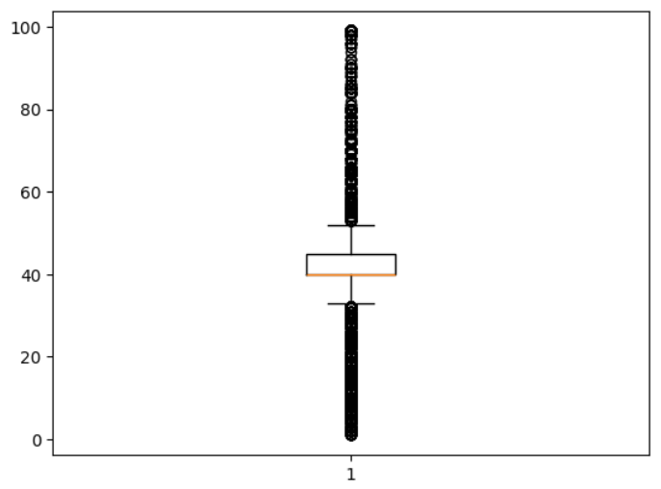
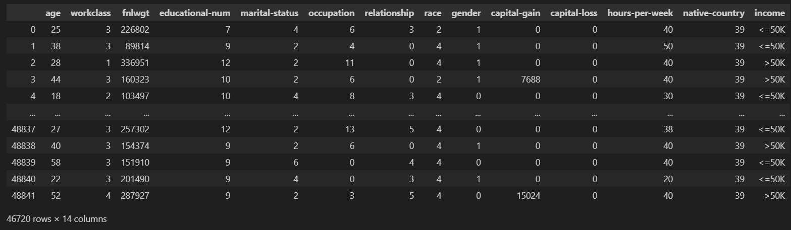
Result

Slide 12
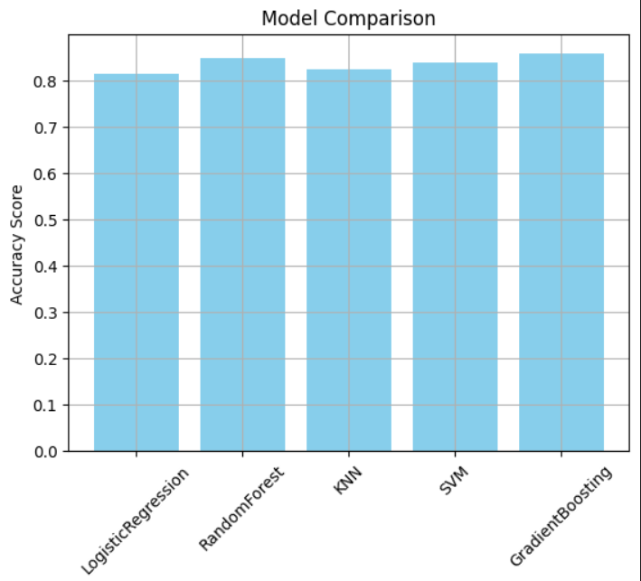
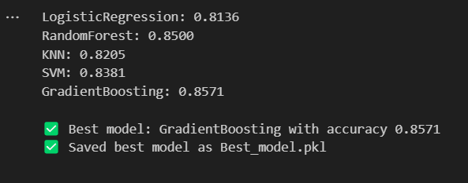

Slide 13
Github link:
https://github.com/atulsinghrajput2022/EMPLOYEE-SALARY-PREDICTION-USING-LINEAR-REGRESSION.git

Slide 14
Conclusion
The objective of this project was to develop a predictive model to estimate employee salaries based on various factors such as years of experience, education level, job title, and location. Using Linear Regression, a straightforward and interpretable machine learning algorithm, we successfully built a model that can provide reasonable salary predictions.
The results demonstrated that experience and job title are strong indicators of salary, and the model achieved a satisfactory performance based on evaluation metrics like R² score and Mean Squared Error. This confirms the effectiveness of the proposed approach for datasets that exhibit a linear relationship between features and the target variable.
However, several challenges were encountered during implementation:
Managing missing or inconsistent data

Slide 15
Handling categorical variables, which required encoding
Dealing with outliers and nonlinear trends, which limited the model's accuracy
To improve the system, future work can focus on:
Implementing more advanced algorithms (e.g., Random Forest, Gradient Boosting)
Performing feature selection and engineering to enhance model input
Using regularization techniques to reduce overfitting
Building a user-friendly interface and deploying the model in a real-time environment
In summary, the proposed solution provides a solid foundation for salary prediction and can be further refined for enterprise-level applications by addressing current limitations and incorporating additional data sources.

Slide 16
Future scope(Optional)
Future Scope & Potential Enhancements
To improve the accuracy, usability, and scalability of the salary prediction system, the following enhancements and expansions can be considered:
Incorporate Advanced Machine Learning Models
Switch to more robust models like:
Random Forest Regression
Gradient Boosting (e.g., XGBoost)
These models can capture complex, nonlinear relationships and improve prediction accuracy.
Experiment with Deep Learning
For large datasets, explore deep learning models such as:
Artificial Neural Networks (ANNs)

Slide 17
References
EMPLOYEE SALARY PREDICTION USING LINEAR REGRESSION
Pandas: Python Data Analysis Library
Matplotlib and Seaborn for Data Visualization
Joblib: Efficient Serialization for Python
Scikit-learn: Machine Learning in Python
Streamlit : The fastest way to build and share data apps

Slide 18
THANK YOU

